Slide 1
A Function and its Derivative
Created by students in 1st block calculus class

Slide 2
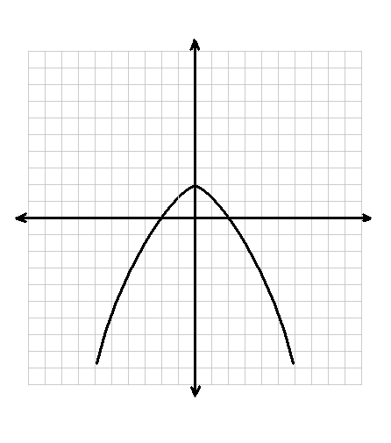
The Function
This function is parabolic.
Domain:
x-intercepts: and
Maxima:
Increasing:
Decreasing:
Concave Down:

Slide 3
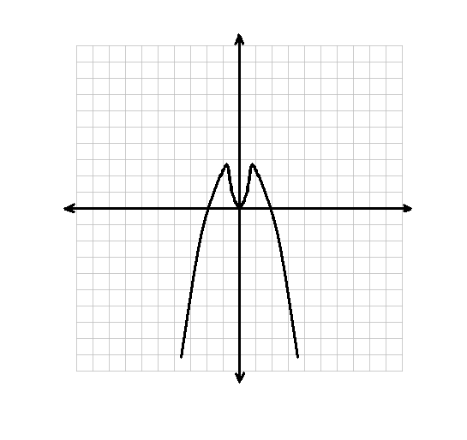
Relative Maxima and Minima
Maxima and Minima
On the original graph
Intercepts on derivative graph
Considering the original graph
Maximum at
An x-intercept should occur at the origin of the derivative graph

Slide 4
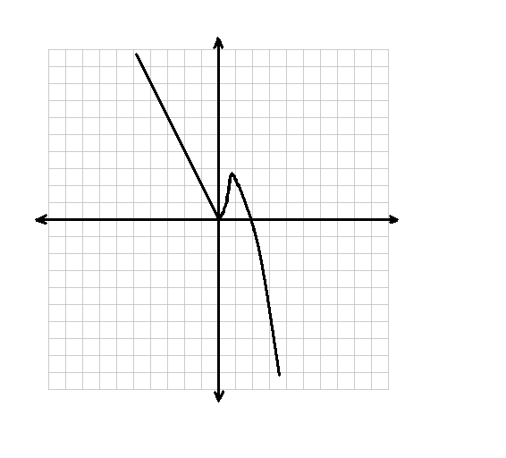
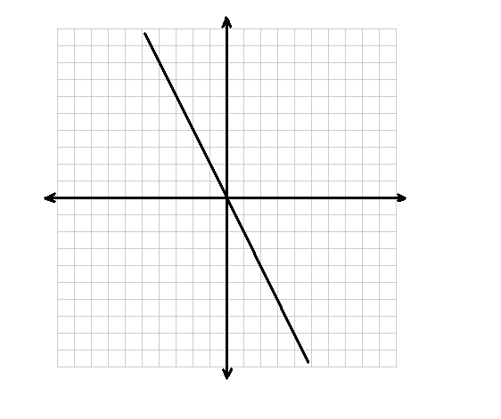
Increasing and Decreasing
Increasing and Decreasing
On the original graph
With the derivative x-intercept
Positive when increasing
Negative when decreasing
Considering the original graph
Increasing from
Decreasing from
The derivative graph should be positive from
The derivative graph should be negative from

Slide 5
Concavity
Concavity
On the original graph
Number of turning points minus one equals the amount of turning points in final graph
Considering the original graph
Concave down from
Only one turning point in the original function—no turning points in derivative function.

Slide 6
Final Derivative Description
This derivative function is a line.
Domain:
x-intercepts:
Maxima or Minima :
When Positive:
When Negative:

Slide 7
Thanks for Watching!

