Slide 1
Piedmont Governor’s School
New Student Orientation
PHCC site

Slide 2
Agenda For the Evening
Purpose and Structure of Governor’s School
Governor’s School Procedures
Advice for a Successful Transition to Governor’s School

Slide 3
Purpose and Structure of Academic Year Governor’s School (AYGS) Programs

Slide 4
Purpose of AYGS Programs
Designed to offer accelerated academic courses for high achieving, motivated, and gifted students.
Regional program that allows for divisions to pool resources together in order to offer advanced academic opportunities for their students.

Slide 5
Structure
Piedmont Governor’s School operates independently from any one school division.
Regional Governing Board is the governing body
Participating school divisions work collaboratively together to provide the direction of the program.

Slide 6
Governor’s School Procedures
What you need to know as new students and parents

Slide 7
Daily Schedule
1st Block: 7:45 am-9:15 am
Break: 9:15 am-9:30 am
2nd Block: 9:30 am-11:00 am
***Students are asked not to arrive at PHCC any earlier than 7:30am***

Slide 8
A-B Block Schedule
Student classes are divided into A days and B days
A Days: Mondays and Wednesdays
B Days: Tuesdays and Thursdays
Fridays: alternate between A day classes and B day classes
Most classes meet for an entire year, however the research classes only meet for one semester each.

Slide 9
Transportation
Bus transportation is provided by both school divisions.
Students can ride the bus or provide their own transportation to Governor’s School.
Arrive on time
Follow all campus parking guidelines

Slide 10
Academic Year Calendar
Governor’s School operates on a separate calendar than the base school divisions.
Have copies of both calendars in order to avoid confusion throughout the year.

Slide 11
Inclement Weather
Governor’s School follows the weather-related decisions of Henry County Schools:
If HCPS is closed, Governor’s School is closed.
If HCPS is on a two-hour delay, there will be no Governor’s School classes.
If HCPS is on a one-hour delay, then Governor’s School will be on a one-hour delay.
Notes:
If Martinsville is closed but Henry County is open, students of MCPS are not required to attend Governor’s School (rare circumstance)

Slide 12
Inclement Weather (cont.)
Early Dismissals: decision will be made in conjunction with base school divisions
Notification of operation changes will be made via automated calls

Slide 13
Attendance
Absences will be excused for the following reasons:
Illness
Death in the family
Medical appointments (note from doctor)
Court proceedings (statement from court)
Religious observances
Participation in school-based activity
College visits (Two per year and approved ahead of time)
Emergencies (determined on a case-by-case basis)

Slide 14
Attendance (cont.)
Documentation from parents must be received within 24 hours of student’s return to school in order to excuse absence.
Graded work will not be allowed to be made up if absence is not excused.

Slide 15
Protocol for Raising Concerns
Student should advocate for themselves in a respectful manner with teacher.
Parent initiate a conversation with the teacher regarding question or concerns.
If unresolved, parents should reach out to Mr. Bocock with question or concern.

Slide 16
Host Site
Be respectful of other classrooms, meeting rooms, offices as you walk through the building.
Only travel through areas that pertain to your classes.
Park in designated areas
Follow any directives from IALR employees
Do not hang around the campus after classes are over.

Slide 17
Commitment to the Program
Governor’s School is designed to be a two-year program
Base school divisions pay for each student to participate
Expectation is once students start, they complete the program

Slide 18
Academic Deficiency
Students are expected to maintain adequate grades while attending Governor’s School.
If GPA is below a 2.0…
After Fall Semester: placed on academic probation
After Spring Semester: will be exited from program
If at any point a student fails a pre-requisite class, they will have to return to their base high school for the following semester.

Slide 19
Advice for a Successful Transition

Slide 20
Tip #1
Have a Growth Mindset

Slide 21
Governor’s School classes will be more challenging than what you may have experienced previously in school.

Slide 22
A’s = Intelligence

Slide 23
Intelligence
Deliberate Practice
Fixed?
Grown?

Slide 24
“I do not have it…
YET.”

Slide 25
Tip #2
Keep Grades in Proper Perspective

Slide 26
GPA KILLER!!!

Slide 27
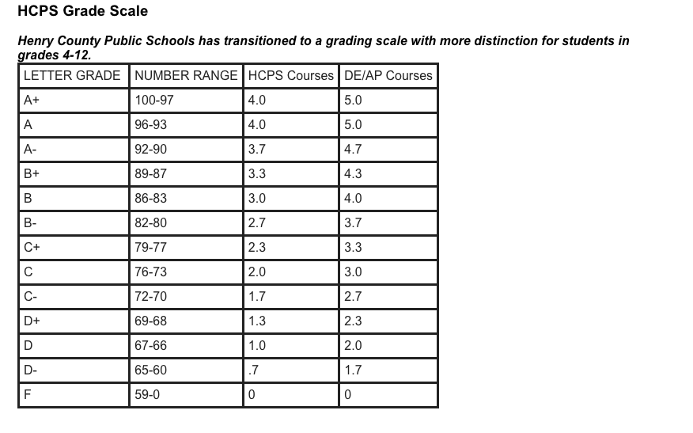

Slide 28
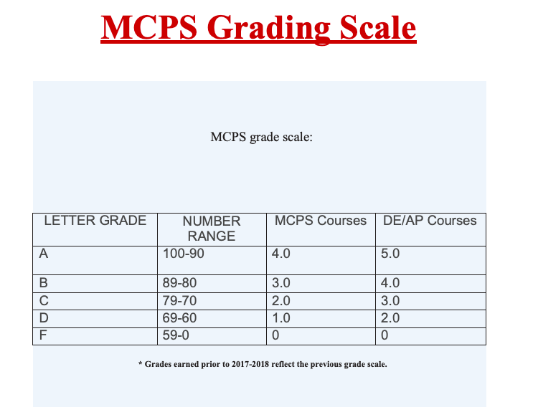

Slide 29
Tip #3
Collaborate Rather than Compete

Slide 30
Community of Learners

Slide 31
Tip #4
Time Management

Slide 32
Up until now, you probably have not had to…
Study to get A’s on a test
Complete homework
Read books for class
Write essays/papers

Slide 33
Time Management Basics
Use a planner or calendar
Complete homework on the day it is assigned/taught in class
Set aside a specific time for work
Set aside a specific area to do your work
Put away the cell phone

Slide 34
Tip #5
Managing Stress and Anxiety

Slide 35
Suggestions to Help Manage Stress
Take time for yourself each day
Do not quit everything
Stay physically active
Maintain a regular sleep pattern
Do not procrastinate
When you’ve got it, you’ve got it.

